Slide 1
AERO 1 GROUP PRESENTATION

Slide 2
CONTENTS
Project Overview
Business Case
Requirements
Preliminary Design
Final Key Decisions
Aerodynamics
Structures
Propulsion
Systems
Conclusion

Slide 3
PROJECT OVERVIEW
Design a family of two regional aircraft - 80 seats and 100 seats - Flights between minor airports or as feeders to larger airports
Design mission range of 1000nm - Study mission 3 x 300 nautical mile flights
Key design drivers and identified requirements: - Minimum direct operating cost - High operational reliability and manufacturability - Commonality vs. optimisation of specific variant - Business case & competition

Slide 4
BUSINESS CASE
Success of this project depends upon market outlook, current/future trends, conformity to upcoming regulations.
Airbus/Embraer Outlook Reports ICAO and EASA Regulations Oil forecasts
Regional aircraft competitors were identified alongside their regions of operation.
Mature- Europe and USA (replacement) Emerging- Asia-Pacific (growth)
Research allowed visualisation of the project helping to further refine initial requirements.
Designing for longevity = SUCCESS

Slide 5
REQUIREMENTS ANALYSIS
Preliminary Design Specification (PDS) outlines customer requirements
Task specification and the European Aviation Safety Agency (EASA) documents including AMC, CS, and International Civil Aviation Organization (ICAO) were used
Airworthiness, operational, environmental, commercial
Quality Functional Deployment (QFD) methods and a House of Quality Matrix used to determined key customer requirements and which engineering challenges were most heavily affected.
Key requirements: Fuel efficiency, passenger comfort, DOC, operational reliability, utilisation in design mission, commonality.
Notes:
At the beginning of the preliminary design stages, requirement analysis was carried out. The task specification, EASA documents including CS and AMC, and ICAO documents were used to draw out necessary requirements which we categorized into four main groups; airworthiness, operational, environmental, and commercial, as explained and outlined in our preliminary design specification. Moving from this towards the preliminary design review, Quality Functional Deployment methods were used to compare rank each requirement , and give them a relative importance based on the customers needs. In addition to this, a House of Quality Matrix, was created to determine which engineering challenges most affected our top six key customer requirements. These key requirements being; high fuel efficiency, high level of comfort for the passenger, low direct operating cost, high operational reliability, high utilization in design mission; essentially a short turn-around time, and high levels of commonality between the two aircraft. These key requirements were consistently referred to throughout all stages of the design.

Slide 6
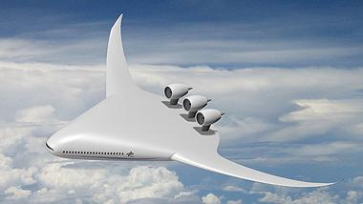
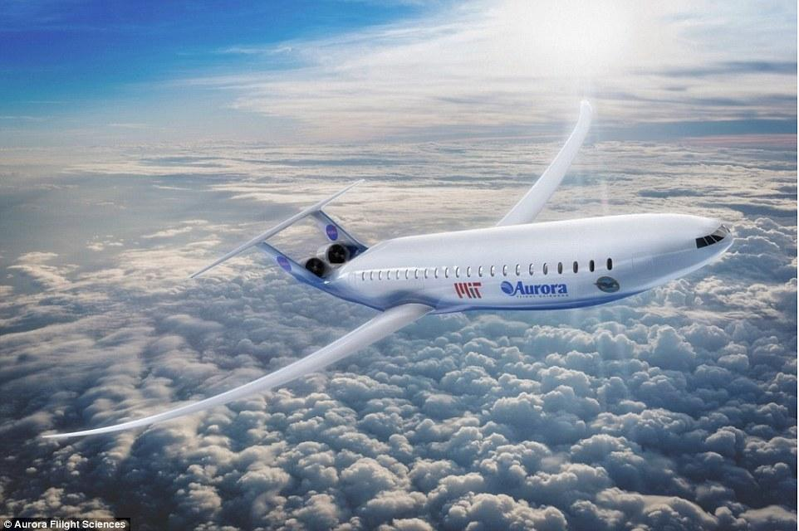
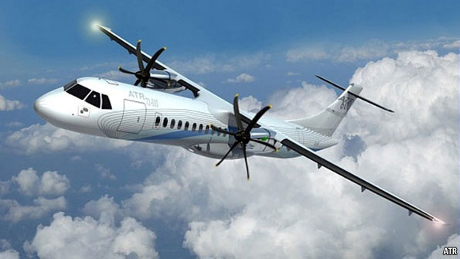
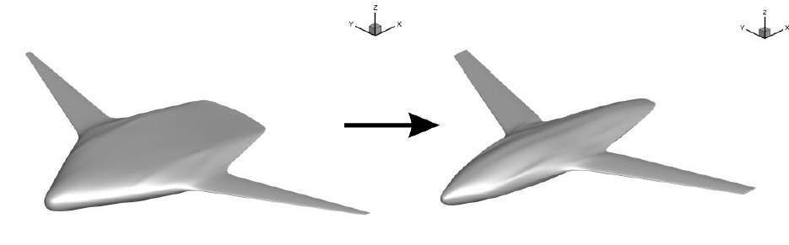
PRELIMINARY DESIGN
Searched for traditional and conceptual design
Blended Wing Body
Achieves lift through the aircraft as a whole
High capacity, fuel efficient and quiet
Conventional Tube Wing
Most developed and widespread
Decades of research and reference
Double Bubble
Double bubble provides structural integrity, fuel efficiency, quiet flight
Fuselage provides lift
Lifting Fuselage
Iteration of BWB, mainly achieving lift from fuselage

Slide 7
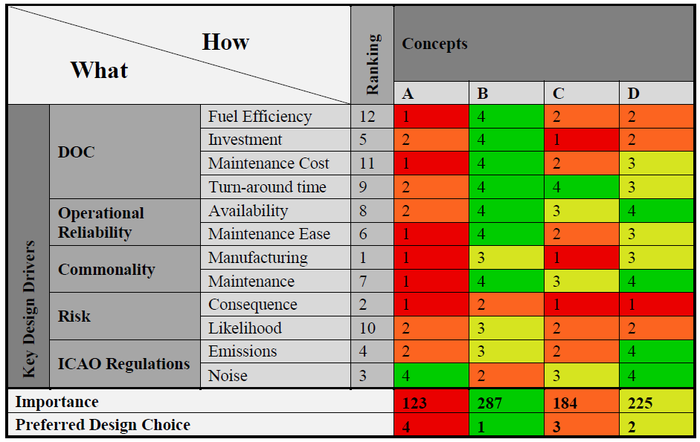
Groups: Aerodynamics | Structures | Systems | Propulsion

Slide 8
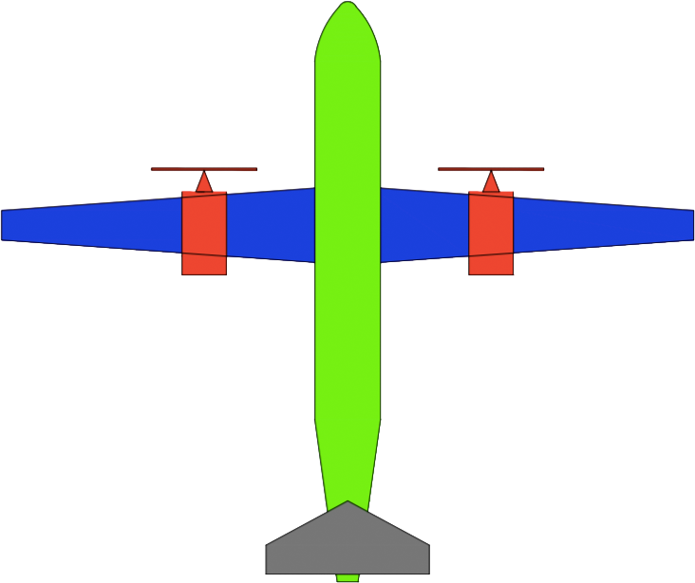
FINAL KEY DECISIONS
Main Wing
High Wing
Straight Wing
High Aspect ratio
Propulsion
Turboprop
Bleedless engine
System
Advanced systems
Empennage
T-tail design

Slide 9
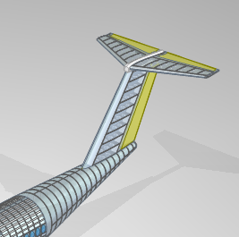
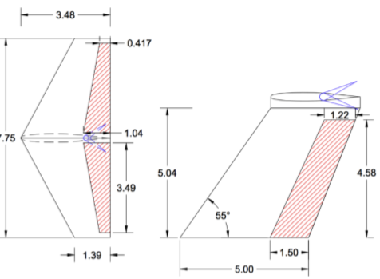
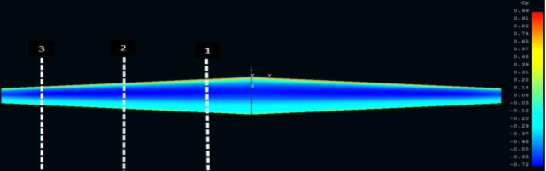
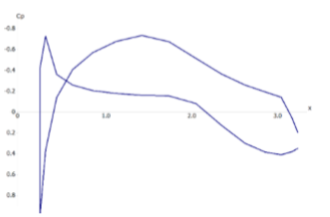
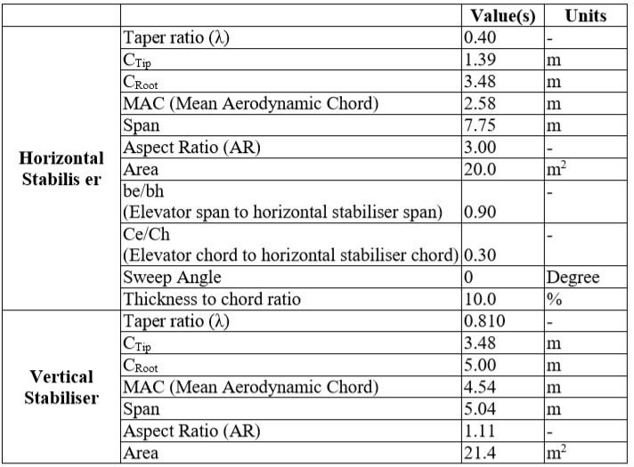
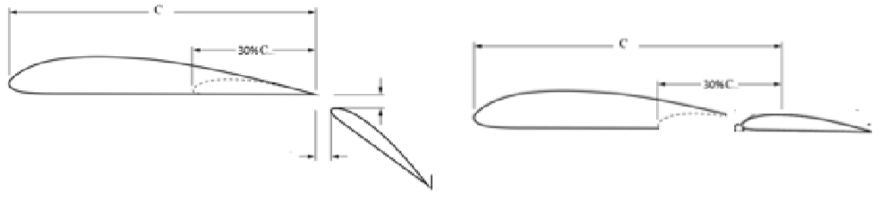
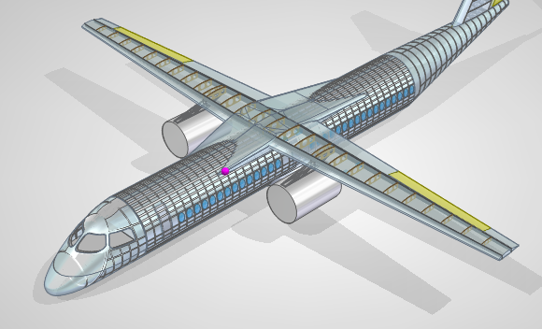
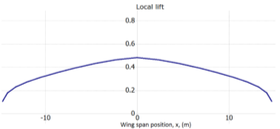
AERODYNAMICS
Iteration process
Main Wing Design
Tail Design
High Lift System Design
T-tail
Fowler flap
Inboard and outboard flap
Operated with separate hydraulics
Tapered wing – subsonic, cost, cheap, Q400 etc
High aspect ratio – drag reduction
15% thickness ratio – Weight, Strength, volume, 41% etc
High wing location – engine, passenger , landing gear, cargo etc

Slide 10
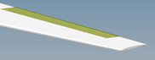
AERODYNAMICS
Ailerons sized with rolling requirements
A rolling rate of 18 degrees per second
Other control surfaces: rudder and elevator
Control surfaces
Static margin changes for different conditions
Biggest change in the 100-seater aircraft
Static Margin
Aircraft | Neutral point (m) | Centre of gravity (m) | Static Margin
80-seater | 14.2 | 13.9 | 7.80-9.89%
100-seater | 16.2 | 15.9-16 | 5.39-8.94%
Both aircraft have the same wing design to reduce manufacturing and maintenance
Commonality

Slide 11

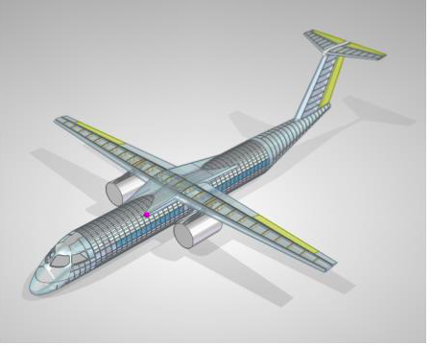
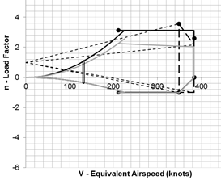

STRUCTURES FUSELAGE
Stringers, Skin, Frames, Cabin floor, Engine pylon, Landing Gear
Design procedure
FOS 1.5 * 2.56 (V-N Diagram)
Commonality: Frame and Stringer Shape, wing box and engine pylon
Reduced weight
30.2 year life cycle (3 flights a day target)

Slide 12
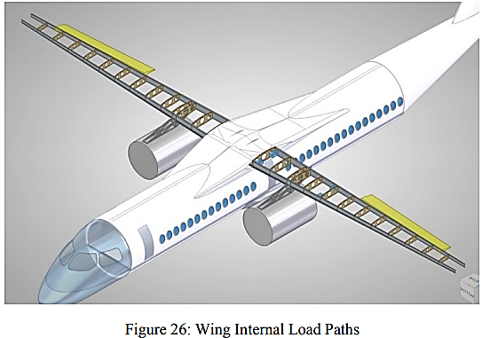
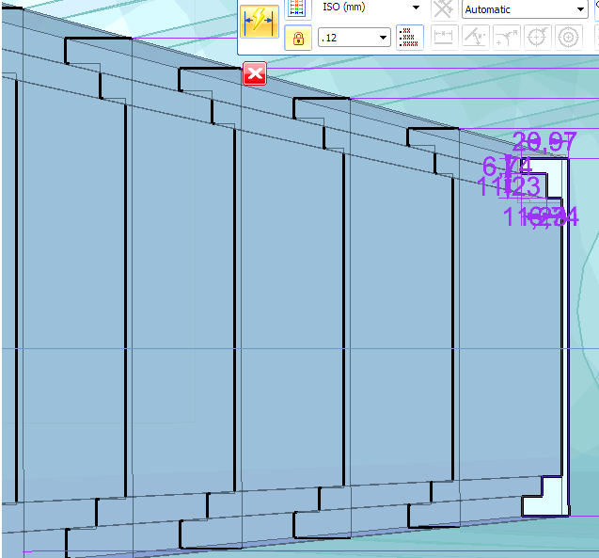
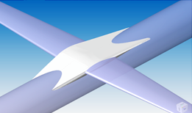
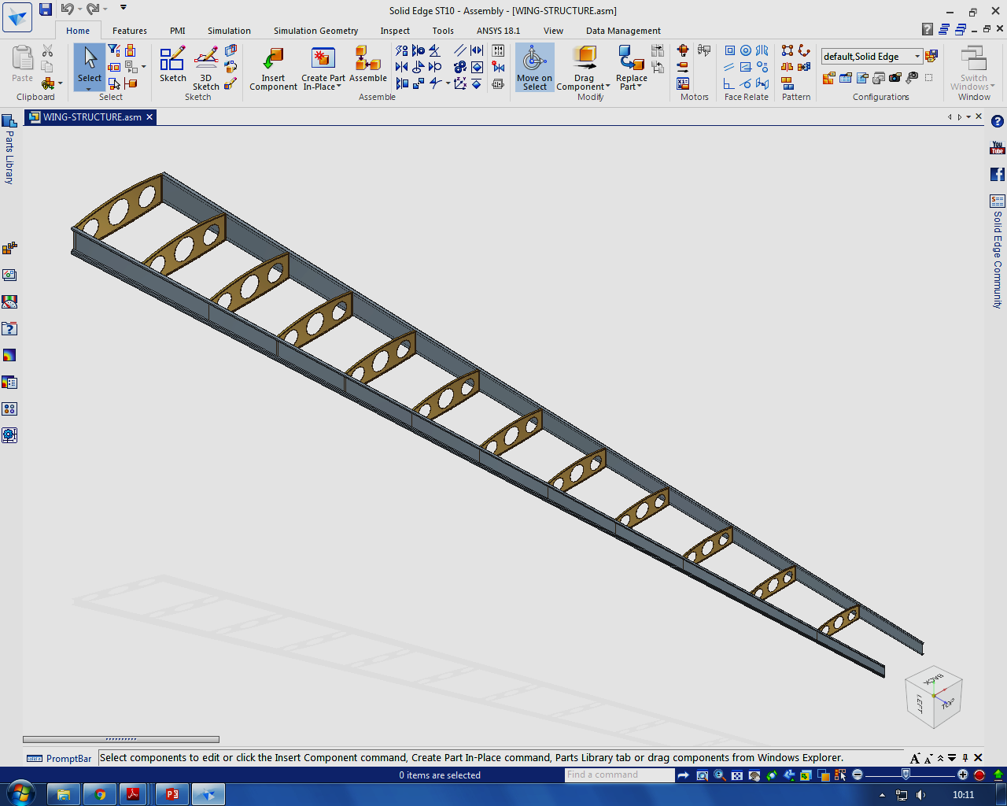

WING STRUCTURAL DEVELOPMENT
Design Development 1- Stringers and skin idealized as Boom areas to size upper and lower skin panels.
Tapered wing box and integrally machined members reinforced by stiffeners.
Arrangement allows for early detection of structural defects.
Design Development 2 – Rib spacing and rib orientation.
Design Development 3 -Wing Box layout and attachment mechanism conform to CS25.571 requirements.
Overall wing is similar in layout, engine location and internal member orientation to the MA700 and Q400.

Slide 13
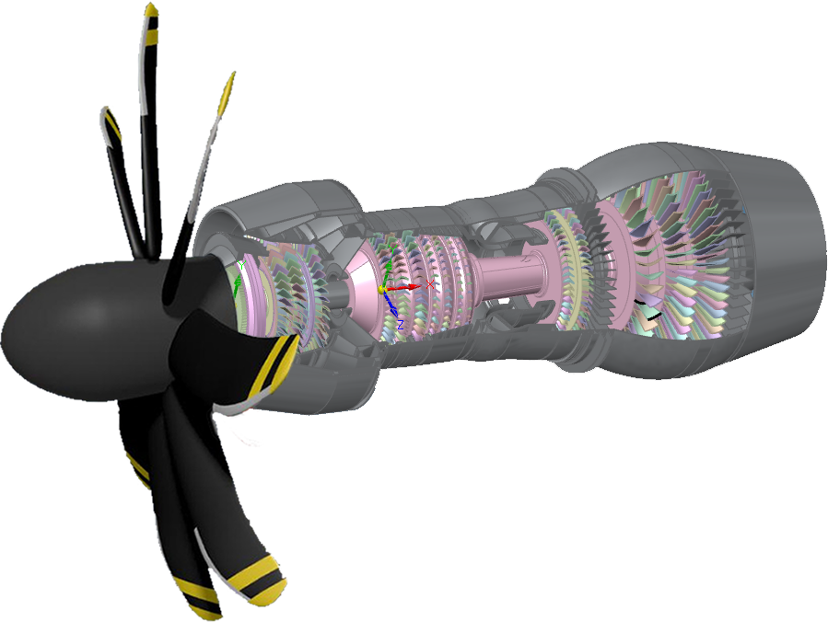
PROPULSION
Turboprop derived from Pratt & Whitney PW1900G Geared Turbofan
High fuel efficiency – main requirement
Best fuel efficiency in 1000G series
95kN static thrust
FH386 – 8 Blade propeller designed for efficiency at high speeds with low operating RPM – Low noise
Performance estimations
Obtained Sea level turboprop performance using Efficiency calculations and scaling laws on Turbofan (PW1900G) manufacturer data
Used scaling functions approximated from typical turboprop performance table
How it stands compared to competitors
Overall efficiency 52%
TSFC of 7 g/kN/s - at least 40% better than typical competitors (CFM56 11-13 g/kN/s)
Fuel per passenger per 100nm 1.8kg and 0.94kg during cruise only. (CS100 > 2kg)
Take-off length 705m and Landing ground roll 542m

Slide 14
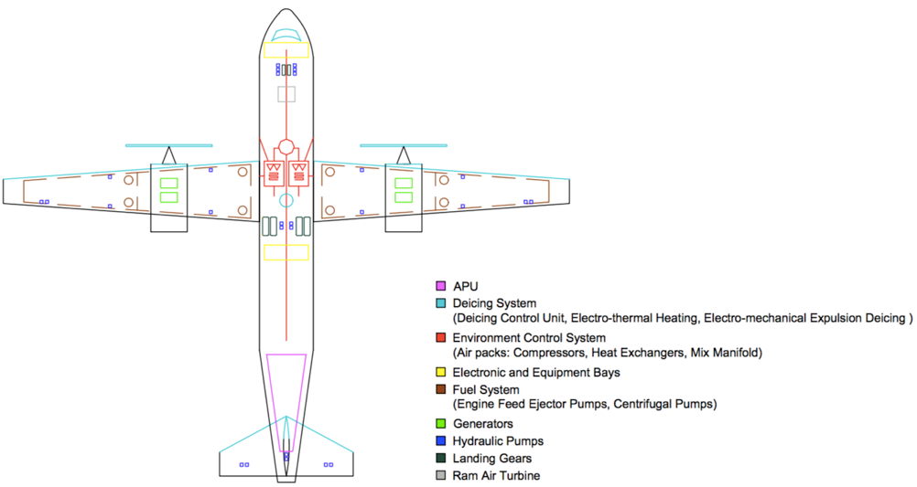
SYSTEMS
Bleedless Architecture
Identical in both aircraft
EHA Hydraulic System
6 Generator Electric System
Digital Fly-By-Wire AFCS with trio triplex architecture
State of the art modern avionics
Notes:
Researched similar aircraft and modern aircraft like the 787. First 'small airliner to be completely electric'
Decided on a bleedless architecture and More electric aircraft- more efficient, reduces weight and DOC which was main target (less engine power extracted.)
Identical systems on both aircraft to achieve commonality and ease of maintenance reducing maintenance costs and manufacturing costs
Hydraulic System- EHA 'power-by-wire system' chosen over central supply- safer, reduces weight and power on demand. Each system is powered by own EHA
Electrical System- No pneumatic systems, 6 generators extracting power from engines and APU. Provides better fuel consumption leading to reduced DOC. Have batteries and RAT to achieve required SIL and improve redundancy and safety.
AFCS- Digital Fly-by-wire system with trio triplex architecture. (3 FCCs with 3 channels from each) Helps meet redundancy and SIL target. Programmed with 3 flight control laws. Normal Law, Alternate Law and Direct Law.
Avionics- All glass flight deck, ILS CAT III landing System, FANS compatible 4D Navigaton System, and Mode-S and ADS-B Enhance Surveillance. All meet customer requirements and CS-25

Slide 15
SYSTEMS
Fuel System
- Dual Functional Architecture with quadruple fuel-feeding routes
- Wing Integral tanks that utilize the concept of fuel collector cells
Rain and Ice Protection System
- All electrically powered
- (ETIPS)Electro-Thermal ice protection and (EMEDS)Electro-Mechanical Expulsion De-icing
Environmental Control System
- Fresh air extraction and self-sustainable cooling for heat exchangers
- Automatic with manual override cabin pressurisation system with redundant circuitry and components comply with CS-25
Notes:
Systems Development: Baseline features were derived from the main flight missions
Fuel system: Pump-feed system integrated into a gravity-feed system Pros: High redundancy to remove any common mode of failure
Fuel collector cells are kept full at all times Pros: Fuel draining in a stable manner with high safety
Rain and Ice Protection System: electrically powered Pros: Higher reliability and reduced energy usage due to the efficiency of power allocation
ETIPS AND EMEDS Pros: Combination of these gives lower power consumption and the least weight

Slide 16
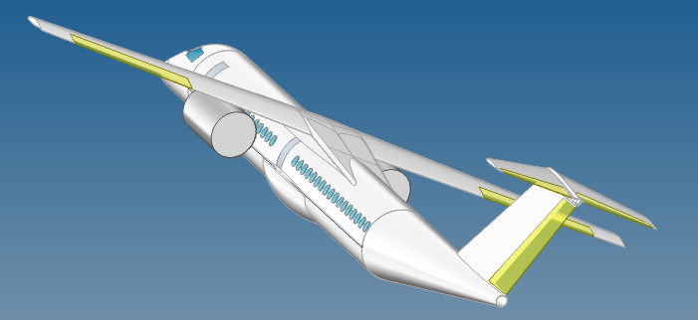
CONCLUSION
The Aircraft
How did we get to this aircraft?
What are our design features?
What would we change?
Notes:
1. The aircraft is an over-wing, turboprop engine, which is a turbofan without the bypass, and a propeller instead of a fan. The T-tail is in use so that engine turbulence won't affect control.
2. We started with various variations of aircraft, followed by group discussion an analysis using various QFD methods to decide on our configuration. From here we chose choices likely commonality with the fuselage, the engine type and system required on the aircraft. We moved onto designing the structures based on loads and load factors, this being produced from our flight data. The specific engine was chosen and the airfoil was chosen. This allowed for a final placement of parts to obtain the correct c.g and wing position.
3. Turbofan engine as a trubo-prop
Light Aircraft with a long life span due to material costs
Good cockpit view designed like Mitsubishi
Commonality
Material Choice
Weight
DOC
4. Wing Airfoil
Material choices throughout the aircraft
Tail Length

Slide 17
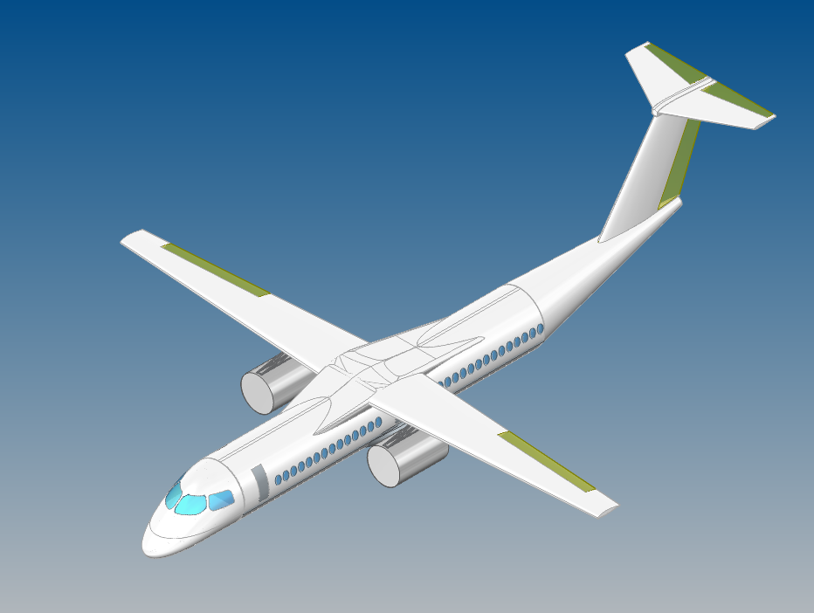
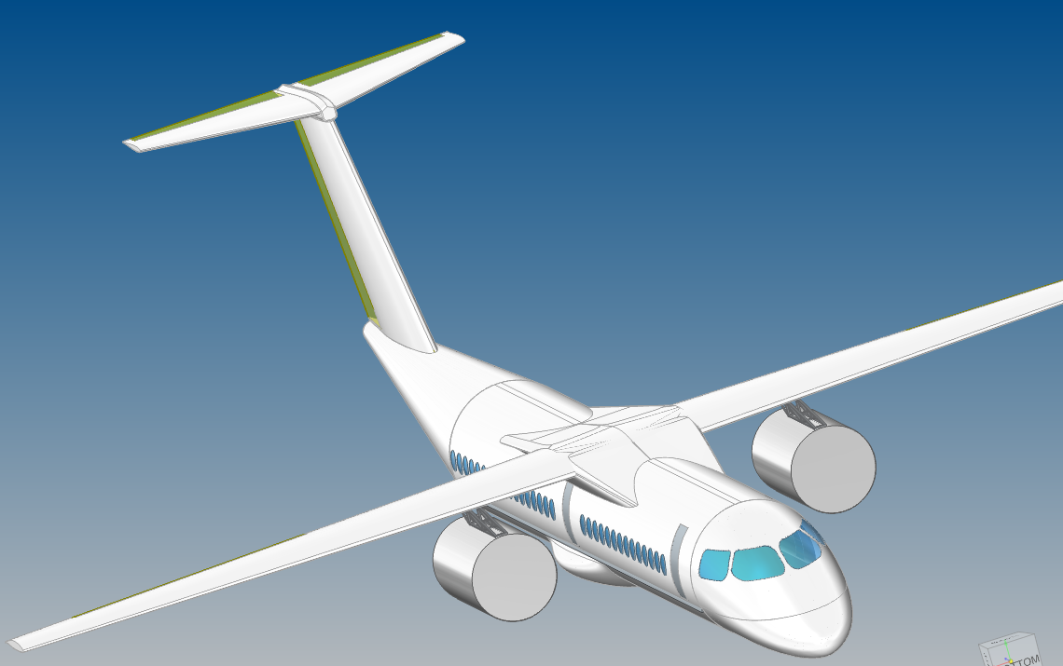
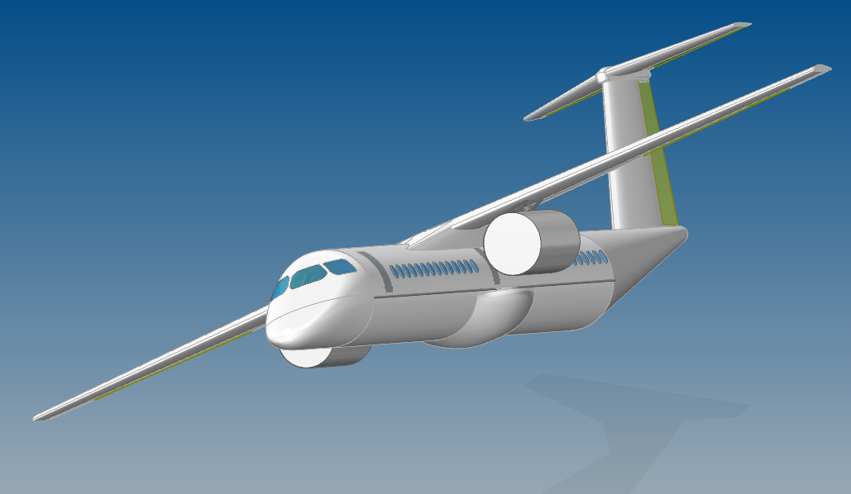
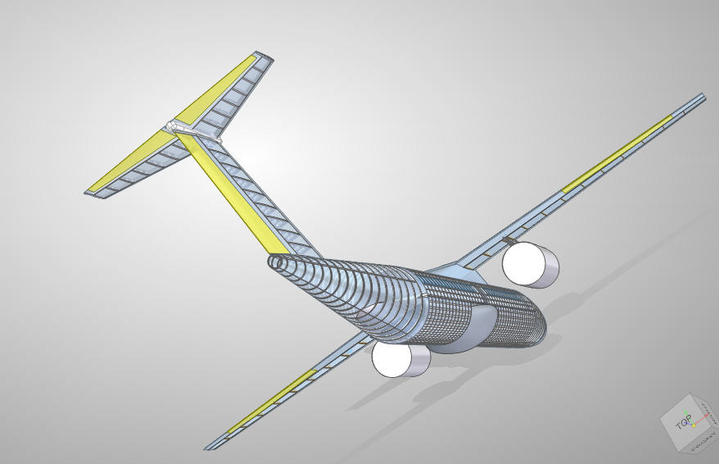
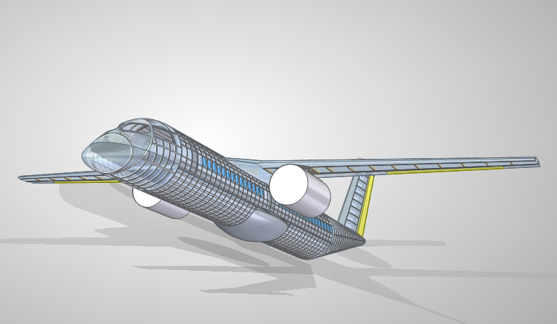
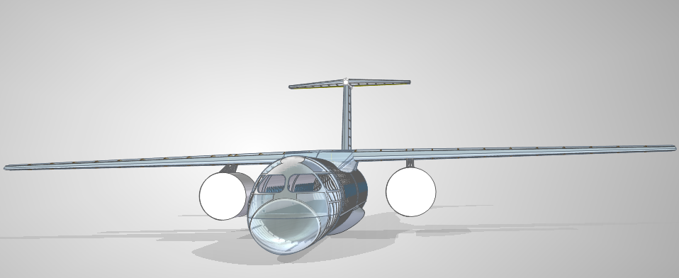
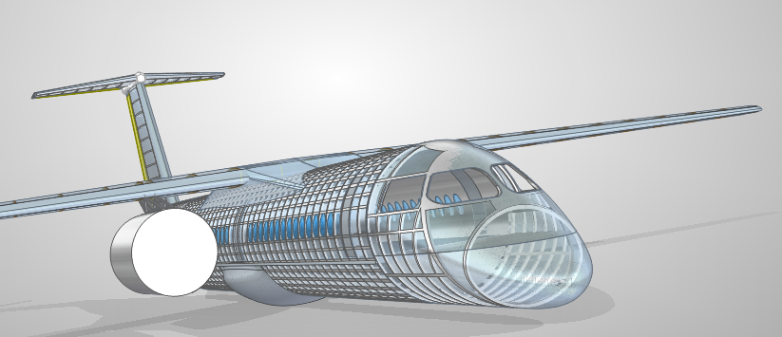
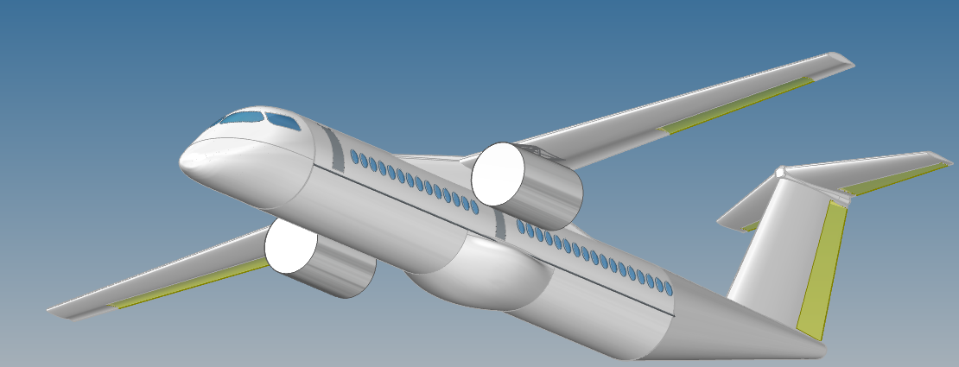
QUESTIONS?

Slide 18
PEOPLE
Max- Systems
Kieran- CAD/Conclusion
David- Business Case
Michael- Systems
Henry- Final Design
Harry- Requirements/PDR
David- Structures
Amr- Preliminary Design
Silas- Aerodynamics
Mahmud- Aero 2
Elysia & David- Project Overview
Nisha- Structures
Viktor- Propulsion
Project Overview
Business Case
Requirements/PDR
Preliminary Design
Final Design
Aero
Aero 2
Structures
Structures 2
Propulsion
Systems
Systems 2
CAD
Conclusion

